Slide 1

DAA · Greedy algorithms
Dijkstra's shortest path algorithm
A greedy way to find the fastest route
Course: Design and analysis of algorithms
Student name: Vanshika Gangwani · PRN number: 25070521309
Notes:
Welcome everyone. Today we look at Dijkstra's algorithm, a basic greedy algorithm for graphs.

Slide 2
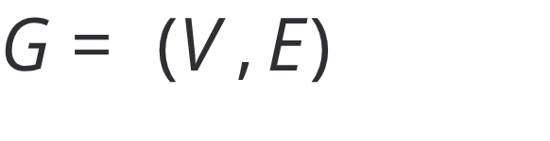
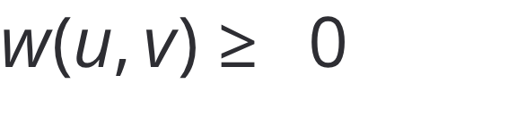


Problem statement & applications
Shortest paths power route planning
Given a weighted graph with non-negative edge weights and source , find the shortest path from to every other vertex in .
Navigation
Networks
Transport
Gaming
GPS & mapping
OSPF & IS-IS
Flight logistics
Game AI
Google Maps finds the quickest route and gives turn-by-turn directions.
Routing protocols that find the shortest paths for data in a network.
Planning flights with many stops, and routes for cargo and vehicles.
Game characters find their way around obstacles in real time.
Notes:
We start with the shortest path problem and see how Dijkstra is used in real life.

Slide 3

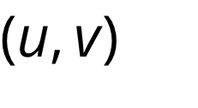
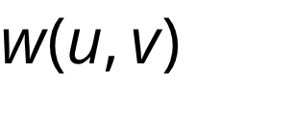
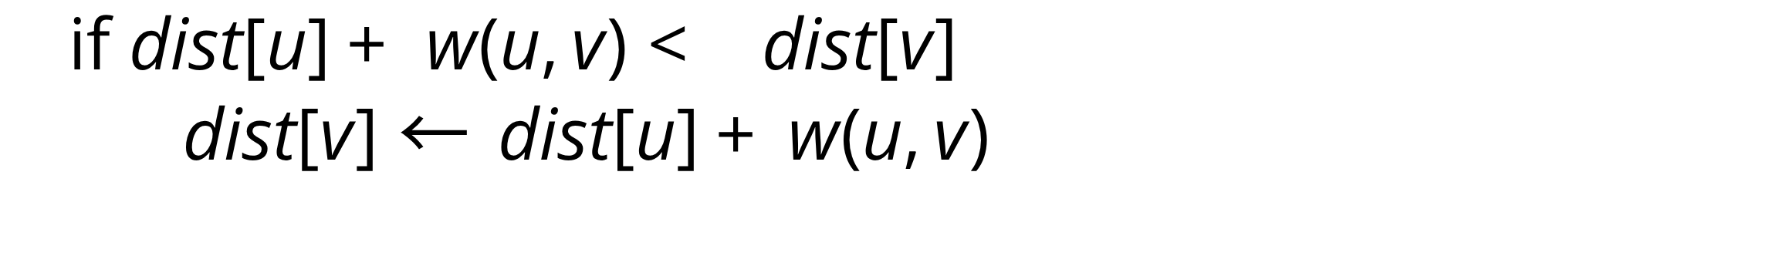

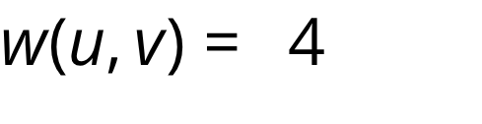
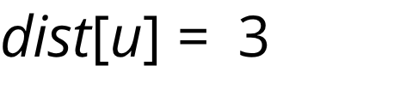
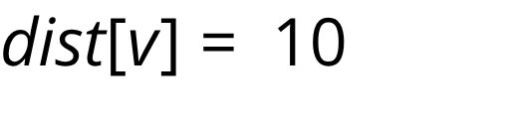
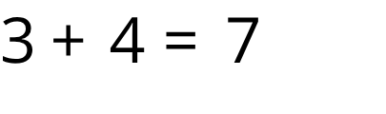
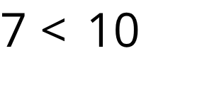
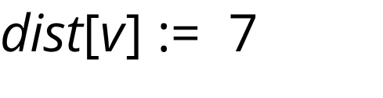
Core mechanism
Greedy choice plus edge relaxation
Think of a ripple
The relaxation rule
Imagine dropping a pebble into water at source . The ripple spreads out evenly and reaches near vertices before far ones.
For edge with weight :
Greedy choice
Also save so we can rebuild the path later.
Pick the unvisited vertex with the smallest distance so far.
Lock in its distance, then relax every neighbor.
Edge relaxation trace: edge ,
Before · ; (old)
Evaluate · ; , so relax.
After ·
Notes:
Explain greedy choice: we always pick the unvisited node with the smallest distance, because non-negative edges mean its distance can never get smaller later.

Slide 4
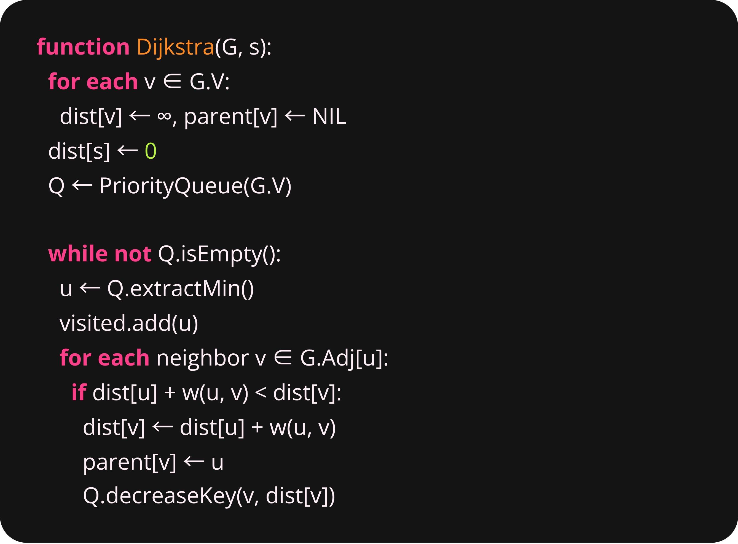
Step by step
The algorithm: six repeatable steps
1. Initialize distances
Set dist[s] = 0 and dist[v] = ∞ for all v ≠ s.
2. Build priority queue
Put all vertices V in the queue, ordered by their dist values.
3. Extract minimum
Take out vertex u with the smallest dist from queue Q.
4. Finalize vertex u
Mark u as visited; its shortest distance is now final.
5. Relax outgoing edges
For each neighbor v of u: update dist[v] if dist[u] + w(u,v) < dist[v].
6. Loop until empty
Repeat steps 3–5 until Q is empty.
Notes:
Walk through the pseudocode step by step. decreaseKey runs whenever relaxation finds a shorter distance.

Slide 5
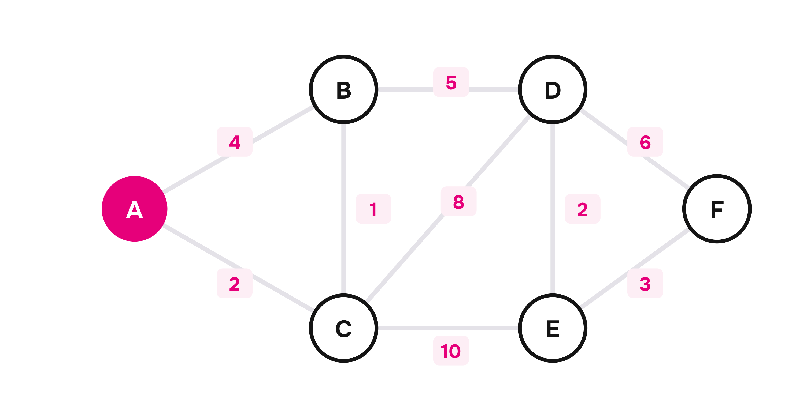
The setup
Worked example: the weighted graph
We find the shortest paths from source A in a graph with 6 vertices (A–F) and 9 weighted edges.
Source vertex: Node A (dist = 0)
Target vertices: B, C, D, E, F (initially ∞)
Edge weights:
A–B: 4 · A–C: 2 · B–C: 1 · B–D: 5
C–D: 8 · C–E: 10 · D–E: 2 · D–F: 6 · E–F: 3
Notes:
Show the example graph. Notice edge B-C with weight 1: it makes an indirect route shorter than edge A-B.

Slide 6
Execution trace
Each iteration improves the frontier
Orange cells show distances that were relaxed; green cells show the vertex picked and finalized at that step.
Iteration | Picked | dist[A] | dist[B] | dist[C] | dist[D] | dist[E] | dist[F]
Initial | — | 0 | ∞ | ∞ | ∞ | ∞ | ∞
Step 1 | A (0) | 0 | 4 | 2 | ∞ | ∞ | ∞
Step 2 | C (2) | 0 | 3 | 2 | 10 | 12 | ∞
Step 3 | B (3) | 0 | 3 | 2 | 8 | 12 | ∞
Step 4 | D (8) | 0 | 3 | 2 | 8 | 10 | 14
Step 5 | E (10) | 0 | 3 | 2 | 8 | 10 | 13
Step 6 | F (13) | 0 | 3 | 2 | 8 | 10 | 13
Notes:
Look at Step 2: when node C is picked with dist 2, it lowers B from 4 to 3, and D from infinity to 10.

Slide 7
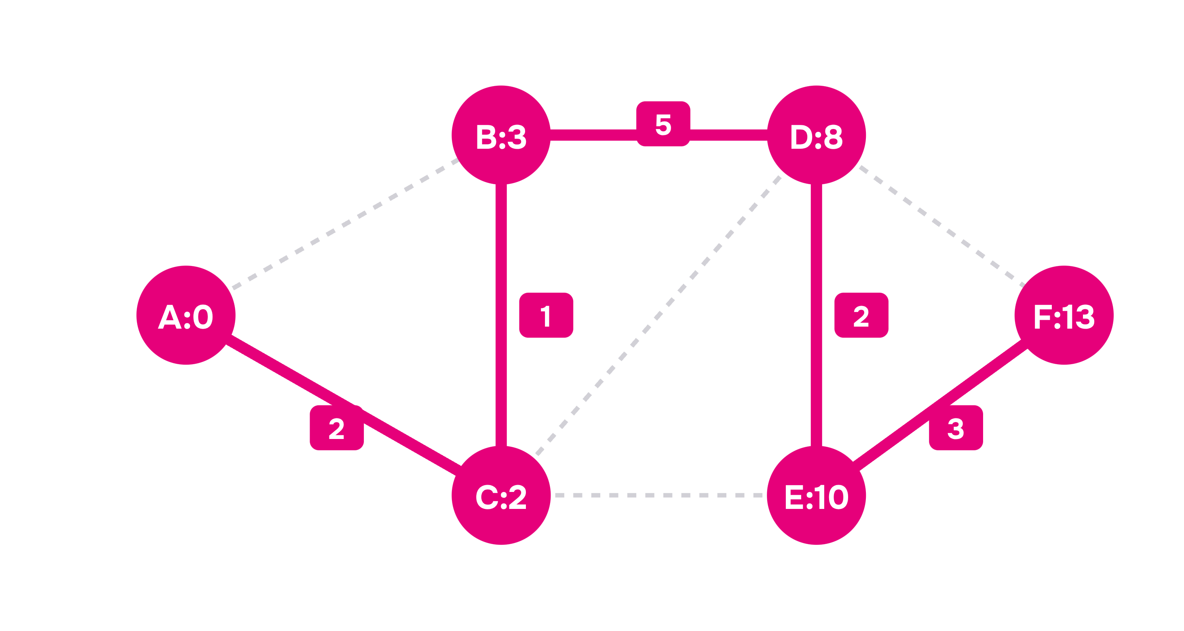
Final result
The shortest-path tree emerges
To B: A → C → B (cost 3)
Beats direct edge A–B (cost 4)!
To C: A → C (cost 2)
To D: A → C → B → D (cost 8)
To E: A → C → B → D → E (cost 10)
To F: A → C → B → D → E → F (cost 13)
Notes:
Point out that the direct edge A-B is not used, because A->C->B costs 2+1=3, which is less than 4.

Slide 8

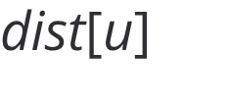


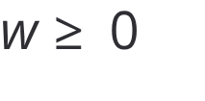
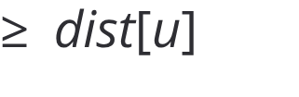

Speed & correctness
Performance follows the data structure
Implementation | Extract-min | Decrease-key | Total time
Array / Matrix | O(V) | O(1) | O(V^2)
Binary min-heap | O(\log V) | O(\log V) | O((V+E)\log V)
Fibonacci heap | O(\log V) | O(1) amort. | O(E + V\log V)
Why it works
Why the greedy choice is safe
When is extracted with minimum , any other path from to must leave the visited set through some unvisited vertex .
Since all edge weights , the distance to is already . More non-negative edges cannot make the path shorter, so is the best possible.
The extra space needed is the same for all of them: .
Notes:
Dense graphs work well with simple arrays or Fibonacci heaps. Sparse graphs like road maps are fastest with a binary heap.

Slide 9
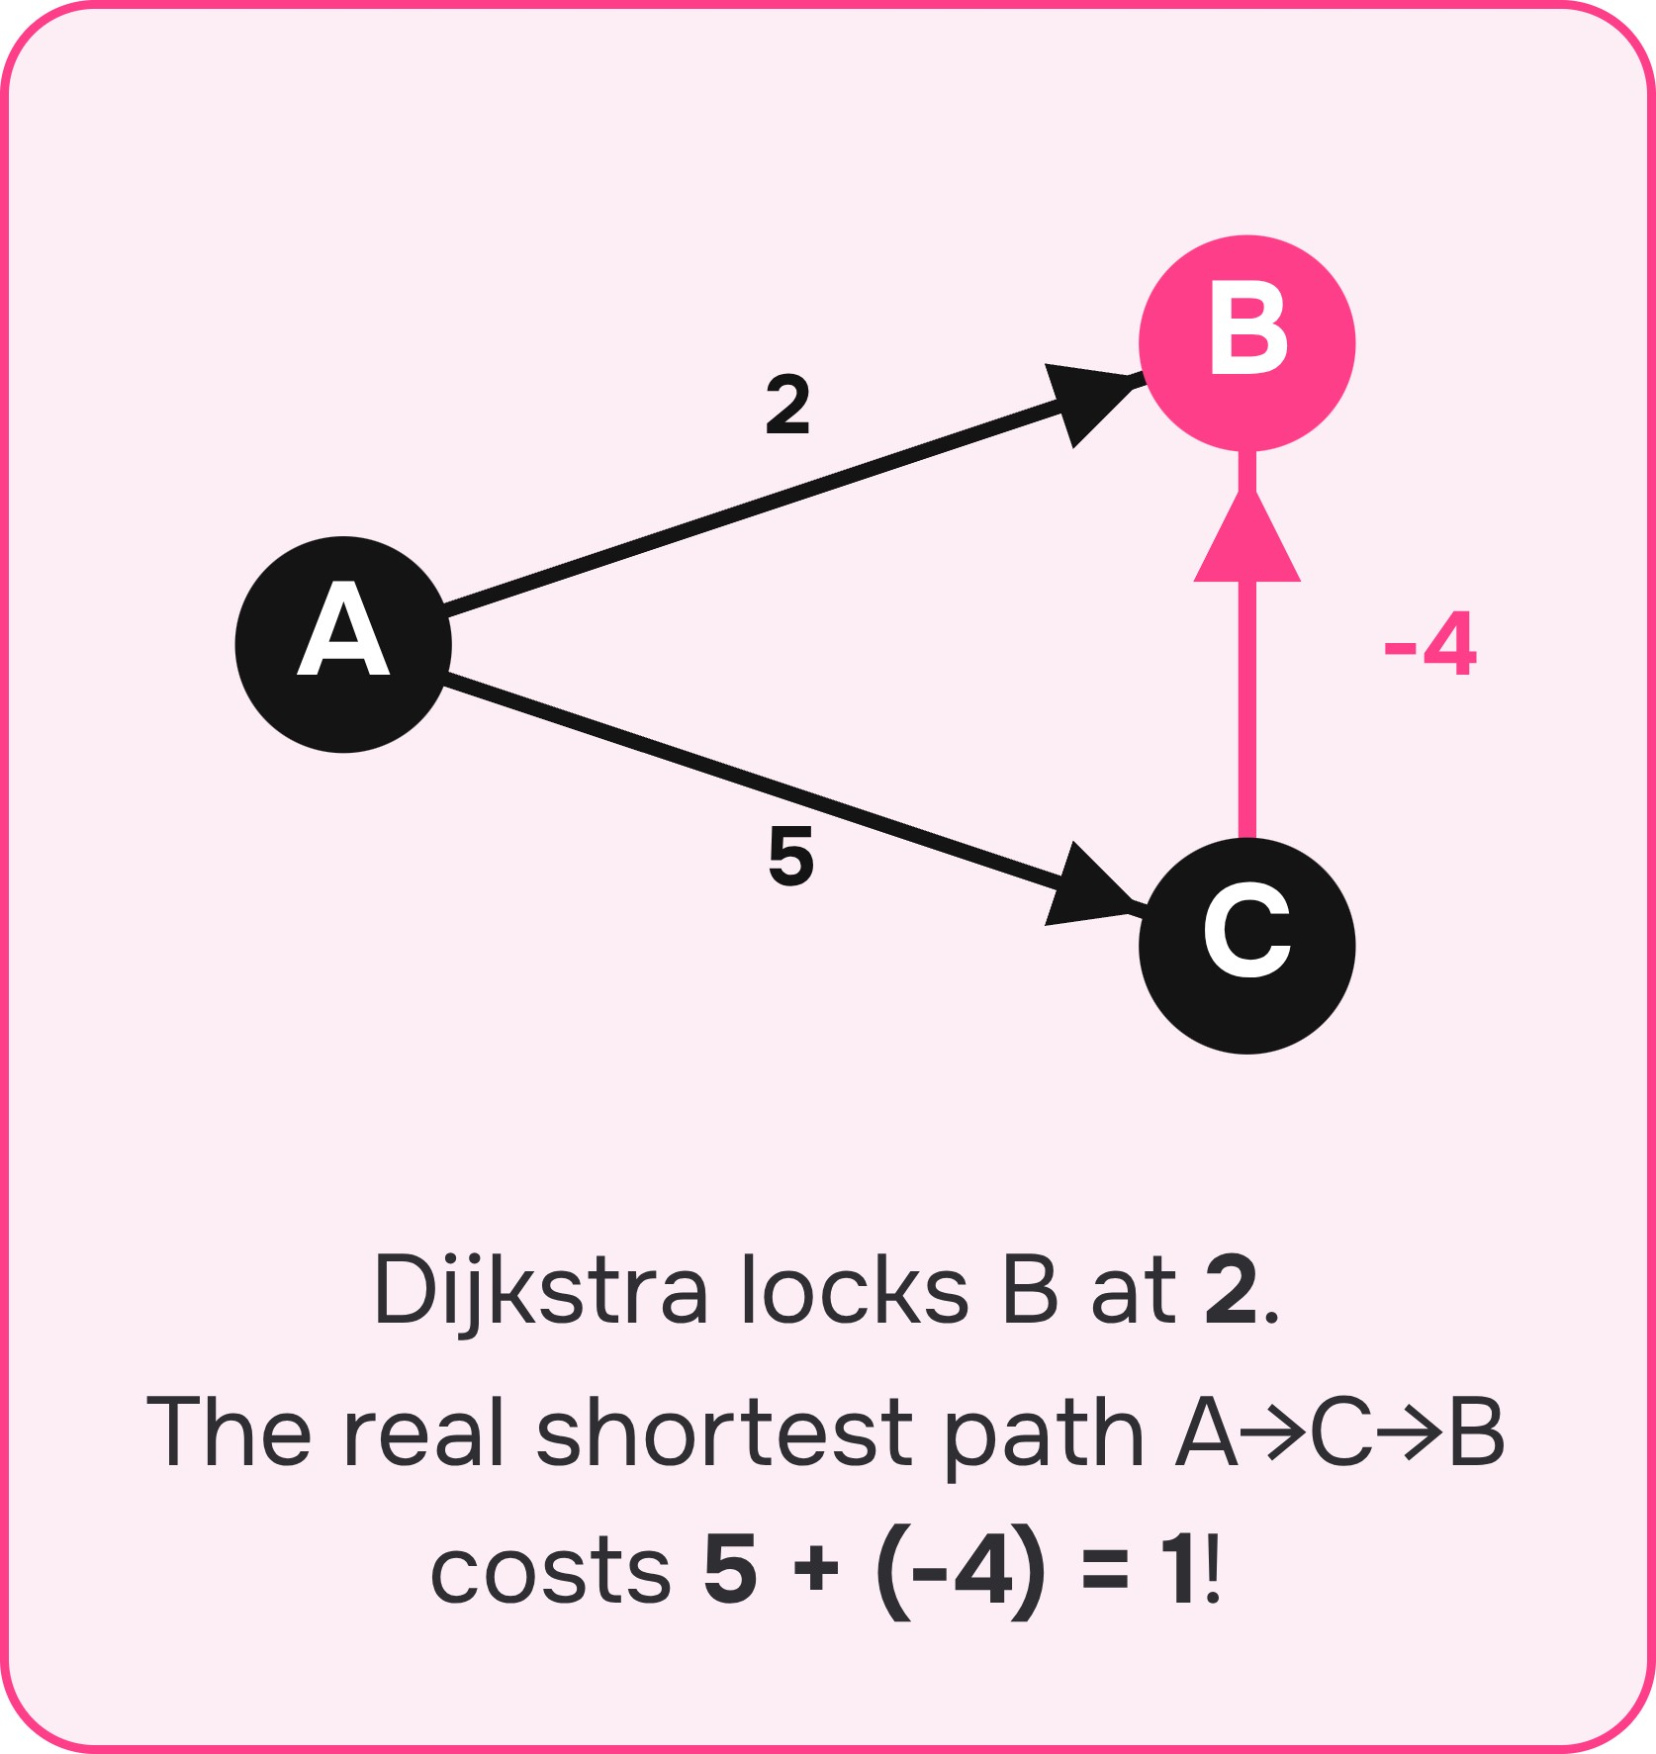
When it fails & other options
Negative edges break the greedy guarantee
Algorithm | Negative edges? | Time complexity | Best used for
Dijkstra | No (fails) | O((V+E)\log V) | Fast on non-negative graphs
Bellman-Ford | Yes (detects cycles) | O(V \cdot E) | Negative edge weights
Floyd-Warshall | Yes (no neg cycles) | O(V^3) | All-pairs shortest paths
BFS | Unweighted only | O(V + E) | Unit edge weights, w=1
Notes:
Dijkstra assumes a path never gets cheaper after a vertex is picked. Negative weights break this, so use Bellman-Ford instead.

Slide 10
Use Dijkstra when weights are non-negative
Advantages & extensions
Limitations
Fast and simple; gives the best answer for non-negative weights.
Extensions: A* search and bidirectional Dijkstra.
No negative weights; single source only.
May visit nodes it does not need.
Takeaway: Pick the nearest unfinished vertex · Relax its neighbors · Non-negative weights make each choice final · The data structure decides the speed.
Thank you / Questions?
Notes:
Sum up the key points: greedy choice, why weights must be non-negative, and how A* builds on Dijkstra. Then take questions.

